Slide 1
ISA² Action 2016.29: Catalogue of public services
Harmonising national
and European service
catalogues

Slide 2
Agenda
Welcome and overview
1
Analysis and modelling of proactive services
4
Taxonomy of public services
2
Change management of CPSV-AP
5
Feasibility study on the modelling of the processes of delivering for public services
3
6
AOB and wrap-up

Slide 3
Welcome and overview

Slide 4
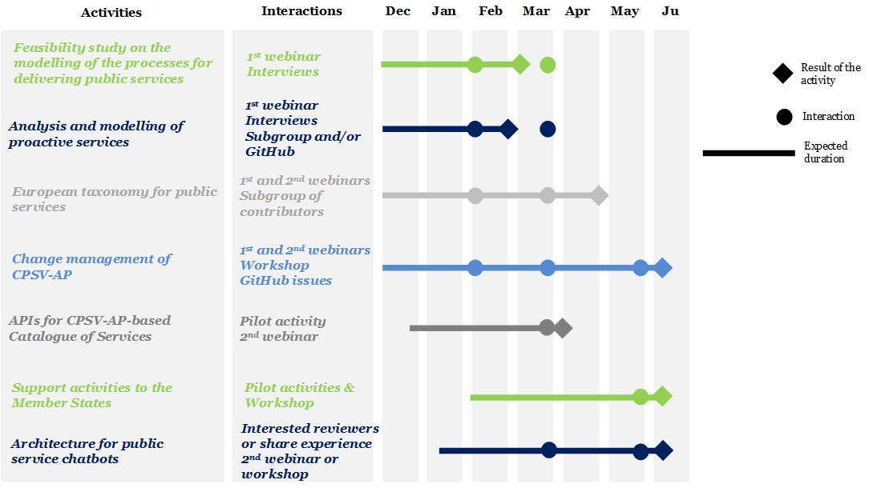
Overview of the activities

Slide 5
Taxonomy public services

Slide 6
Taxonomy of public services
Objective:
Define a first level of generic public services and process the feedback captured from the Working Group during the two webinars.

Slide 7
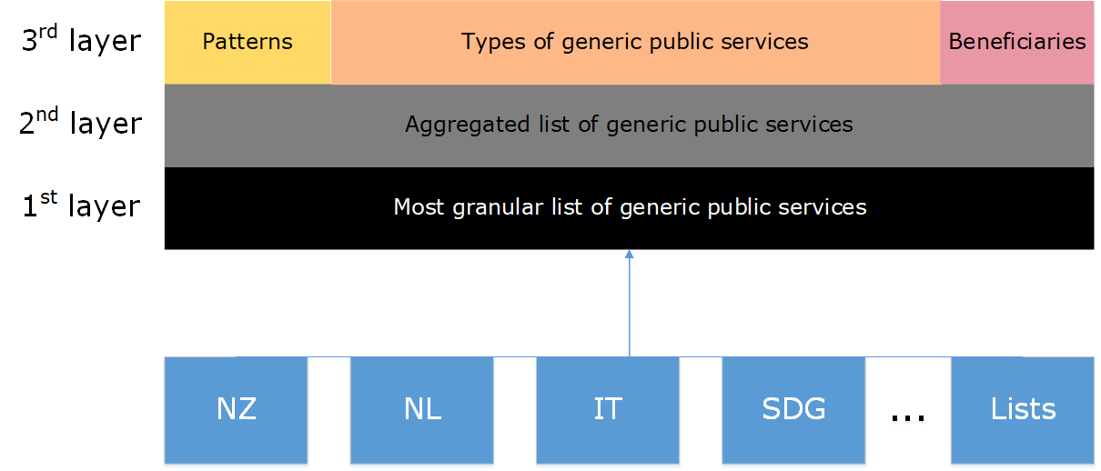
Methodology

Slide 8
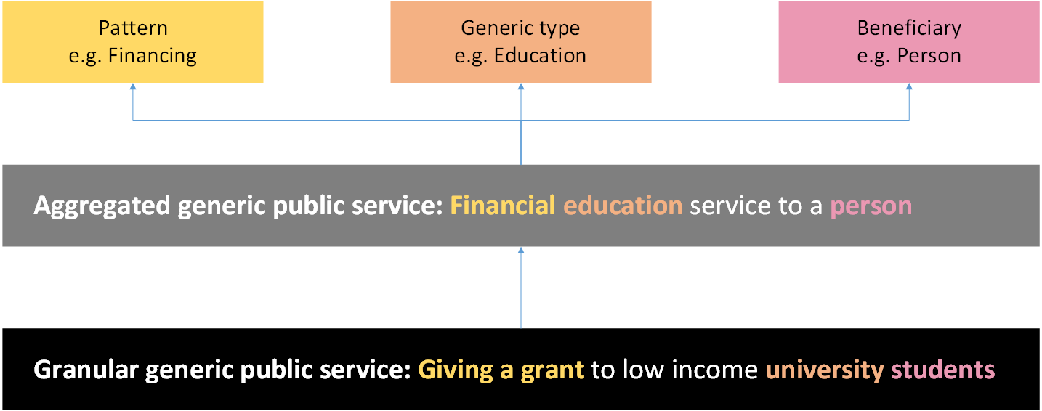
Example

Slide 9
List of patterns and examples of types of generic public services and beneficiaries
Looks very similar to thematic area
Aggregated generic public services (approx. 300)
Business Education Certification service
Business Education Information & advice service
Business Education financing service
....
Government Education Certification service
Government Education Information & advice service
Government Education Financing service
....
Person Education Certification service
Person Education Information & advice service
Person Education Financing service
....
Patterns (11)
Certification service
Information & advice service
Financing service
Framework service
Registration service
Control & monitoring service
Law enforcement service
Executive service
Feedback service
Waste management service
Taxation service
Generic public service types (30)
....
Educational service
....
Looks similar to Agent
Beneficiaries (3)
Business
Government
Person
Notes:
Talk about the difficulties / examples of possible discussion points
Should all terms be completely independent from each other or can a public service be categorised within multiple generic public services (i.e. tags)?

Slide 10
Questions
What would be the most useful outcome of this work for you?
Does the distinction between patterns and generic public service types make sense in your opinion?
When comparing the 1st and 2nd layers, should all the terms from the first layer be classified to only one aggregated generic service (public administration’s perspective) or to multiple ones potentially (user’s perspective)? Do you see those two perspectives as opposite?
For the time being, how should we integrate the legal aspect into this work?
How do you see the value of this list with and without definitions?

Slide 11
Other questions?
We need your feedback!
Share with us your list of existing services, your lessons learnt, use cases etc.
Who would be ready to contribute more actively and review the list created?

Slide 12
Feasibility study on the modelling of the processes of delivering for public services

Slide 13
Feasibility study on the modelling of the processes for delivering public services
Objective:
Analyse the needs and requirements of the WG for harmonising the modelling of processes for delivering public services to citizens, businesses, or another public authority
Questions:
What is the value for you of modelling the delivery processes of public services?
What is the relationship between the delivery processes and the CPSV-AP?

Slide 14
Co-design as a target for modelling public services delivery processes
01
Involve citizens, businesses and other public authorities in the whole service lifecycle
Analysis
Design
For increased visibility, understanding, participation and interoperability of public services.
Public service processes
03
02
Assessment
Sources
New European Interoperability Framework, online
https://ec.europa.eu/isa2/sites/isa/files/eif_brochure_final.pdf.
Modelling public services from a co-design perspective, N. Guarino, K. Taveter (2018) Catalogue of Services workshop, Sofia.

Slide 15
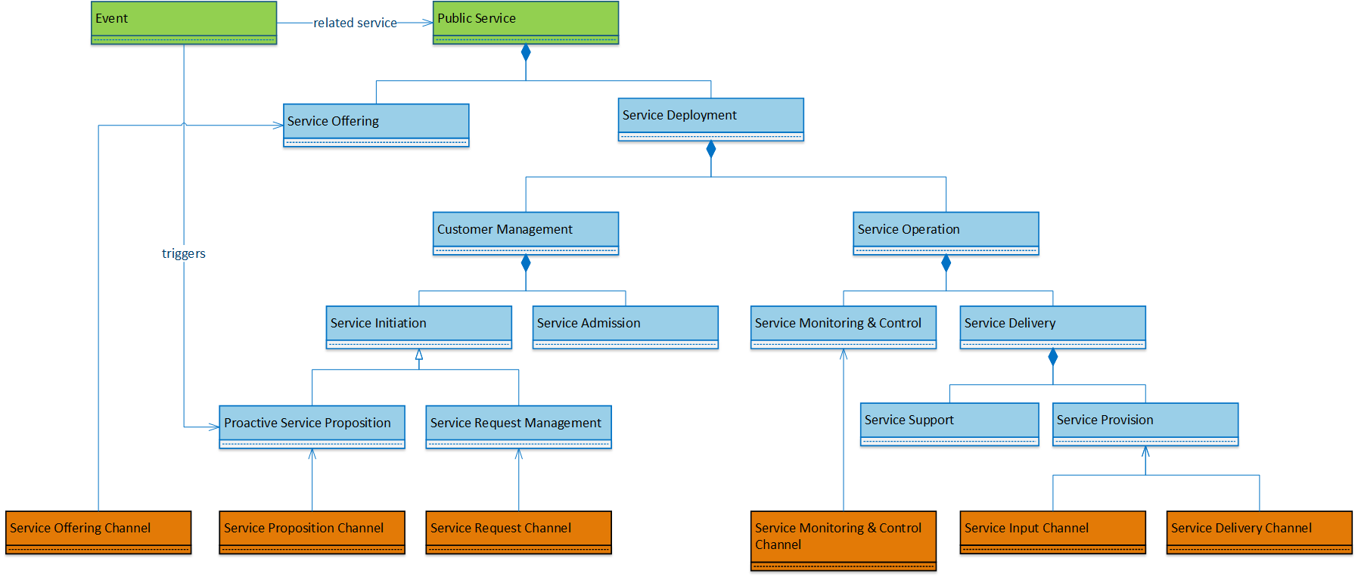
Specializing the CPSV-AP
Could this model be seen as a basis for modelling public service delivery processes?
Could it achieve the benefits of co-design stated before?
Modelling public services from a co-design perspective, N. Guarino, K. Taveter (2018) Catalogue of Services workshop, Sofia.

Slide 16
Alternative approach
Would a similar approach to the one adopted for the taxonomy of generic public services answer your needs?
A bottom-up approach analysing specific service processes from multiple administrations;
Detection of similar steps; and
Creation of generic processes.

Slide 17
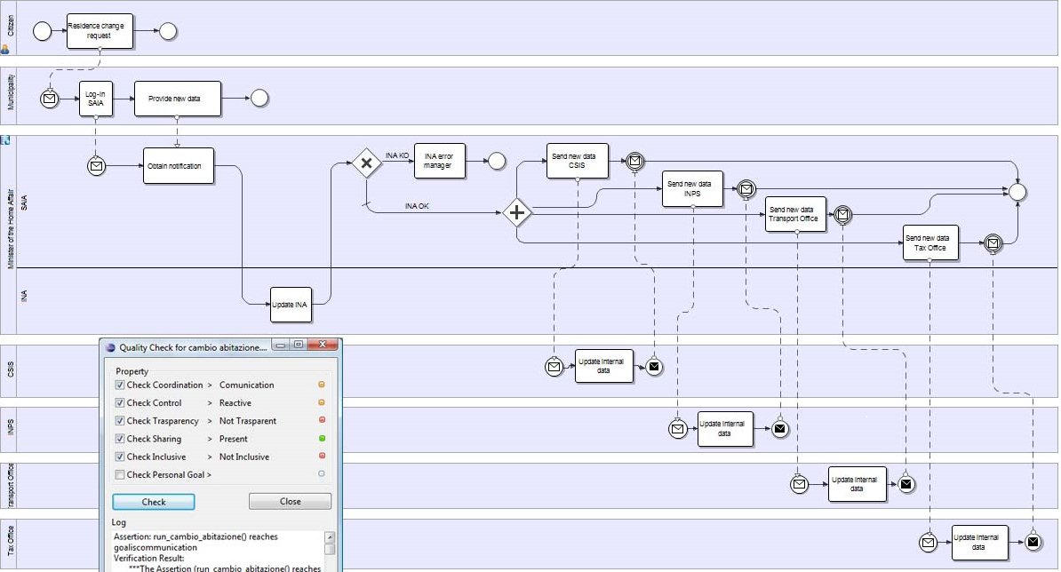
Example for Change of address in Italy
Click on the image (or link below) to access a more readable version.
Innovation on Public Services using Business Process Management
F. Corradini, D. Falcioni, A. Polzonetti and B. Re,
(2011) International Conference on E-business, Management and Economics IPEDR Vol.25 (2011) © (2011) IACSIT Press, Singapore, online https://pdfs.semanticscholar.org/1a21/43c6d923d0342a0bffe002e2687ed77b019d.pdf

Slide 18
Analysis and modelling of proactive services

Slide 19
Analysis and modelling of proactive services
Objective:
Determine how to model proactive services starting from existing practices
Decide whether CPSV-AP should be adapted to include proactive services or whether a new model should be created
Approach:
Qualitative interviews to assess data modelling needs and requirements
Definition of use cases and identification of information requirements
Illustration of the requirements and next steps

Slide 20
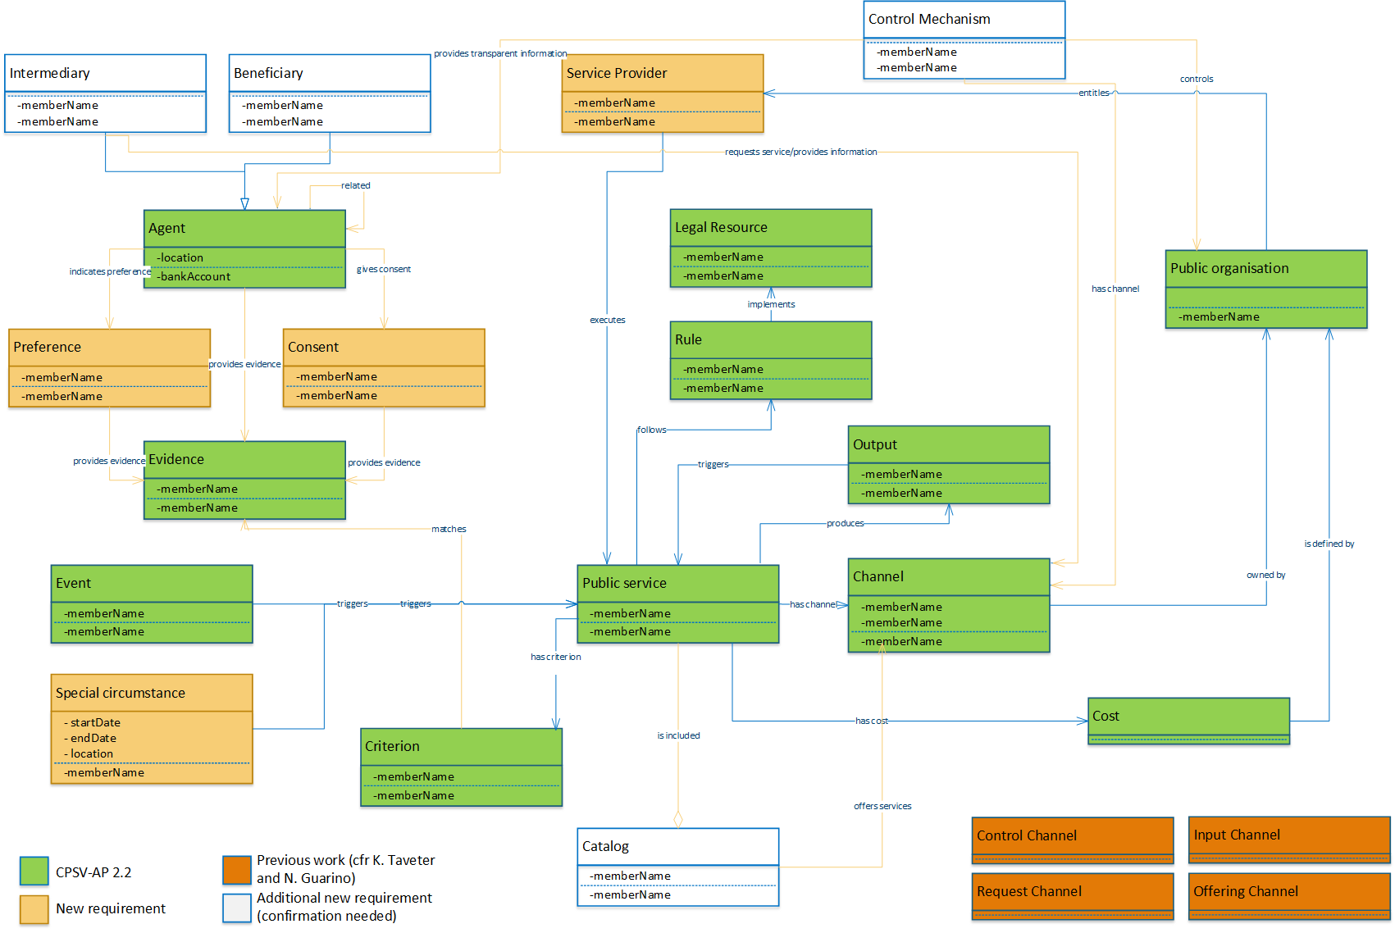

Slide 21
Analysis and modelling of proactive services
Key questions on the representation:
Should any element be added or removed from the representation of the requirements?
What is the best way to model consent and preference?
What is the added value of the “new additional requirements”?
With proactive services, a public service can be triggered in three different manners, do you agree?
For now, how the data is analysed or structured is not represented, are these requirements in your opinion?
A specialization of the class Channel is probably required, how could the work achieved previously (cfr next slide) be included in the representation?

Slide 22
Specializing the CPSV-AP
How to reuse this work without being too prescriptive in the way public administrations structure their service delivery?
Modelling public services from a co-design perspective, N. Guarino, K. Taveter (2018) Catalogue of Services workshop, Sofia.

Slide 23
Change management of CPSV-AP

Slide 24
Open issues from GitHub - overview
spatial - use of the Administrative Territorial Units by local public authorities (Link)
Public Service - Type - authoritative source of the codelist COFOG is not accessible for now (Link)

Slide 25
Issues on specific elements of CPSV-AP
spatial - use of the Administrative Territorial Units by local public authorities (Link)
Description: keeping ATU up-to-date with thousands of local units seems unrealistic for local public authorities.
Proposed solution/action:
Have one property with the public service's territorial range only with the terms "national/regional/province/local/other". This property could be combined with a recommendation to use the ATU or, if impossible, a public service's competent authority address.
A local refinement starting from the ATU itself.

Slide 26
Issues on specific elements of CPSV-AP
Public Service - Type - authoritative source of the codelist COFOG is not accessible for now (Link)
Description: It was identified that the authoritative source of the codelist COFOG referred to in the CPSV-AP specification v2.1 for dct:type of Public Service was no longer publicly available
Proposed solution/action: Plan a web conference between various actors (UN, Member States and European Commission) to inform each other about the objectives and status of the various initiatives, and seek points of collaboration and coordination.

Slide 27
Issues on specific elements of CPSV-AP
ELI Alignment (Link)
Description: Alignment of CPSV-AP with the European Legislation Identifier for Formal Framework, status, related, and type.
Proposed solution/action: Formal Framework was replaced by Legal Resource in alignment with ELI. All other properties were removed, indicating to CPSV-AP users to refer to ELI.
The remaining property in CSPV-AP is “related” (dct:relation) which is different from “relatedTo” in ELI. How should CPSV-AP model this?
Both properties are currently set as optional. We would propose to align to he definition of ELI for “relatedTo” in the next version of the CPSV-AP.
The current definition in CPSV-AP 2.2 is: “This property represents another instance of the Legal Resource class that is related to the particular Legal Resource being described.”
While the definition of “relatedTo” in ELI states: “Indicates a somehow related other document, not necessarily a legal resource. Note that citation links should use the cites property.”

Slide 28
General issues
Classification of a public service (Link)
Description: besides several points already addressed, different dimensions for classifying public services are seen as valuable, such as common or specific purpose, addressee/beneficiary, output type, territorial scope. How should the CPSV-AP tackle this classification? This discussion is also related to this issue.
Proposed solution/action: As part of the work on the taxonomy of public services, ISA² is looking at generic public services from different perspectives (e.g. beneficiaries, patterns, thematic areas), which dimensions should we prioritise?

Slide 29
General issues
Digital aspects of public services (Link)
Description: CPSV-AP does not seem to describe digital aspects of public services, for example for initiating the procedure, to check the status of the request, to interact or to identify electronically.
Proposed solution/action:
From a data model perspective, the concepts of public services being delivered digitally and/or in an automated way are being discussed as part of the activities on proactive services and modelling processes for delivering public services.
From a technological perspective, ISA² is looking into chatbots and APIs for public services.
Do you see the current activities as sufficiently covering this issue?

Slide 30
AOB and wrap-up

Slide 31
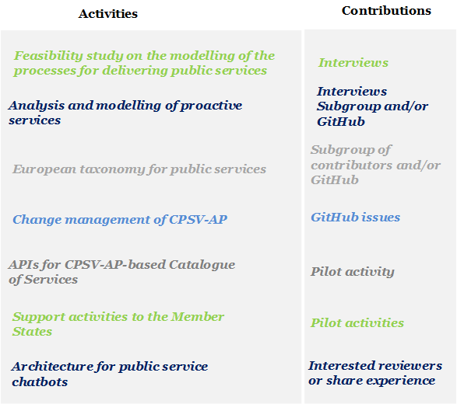
AOB and wrap-up
Contributions:
Change management of the CPSV-AP
Upcoming events:
2nd webinar towards the end of March 2019
Workshop towards the end of May 2019

Slide 32


Thank you!
Project Officer:
Miguel Alvarez-Rodriguez Miguel.ALVAREZ-RODRIGUEZ@ec.europa.eu
https://github.com/catalogue-of-services-isa/cpsv-ap
https://joinup.ec.europa.eu/collection/semantic-interoperability-community-semic
Notes:
Logo Joinup: https://joinup.ec.europa.eu/contact
Logo GitHub: https://commons.wikimedia.org/wiki/File:Github.com-SunghanKim.png

